Slide 1
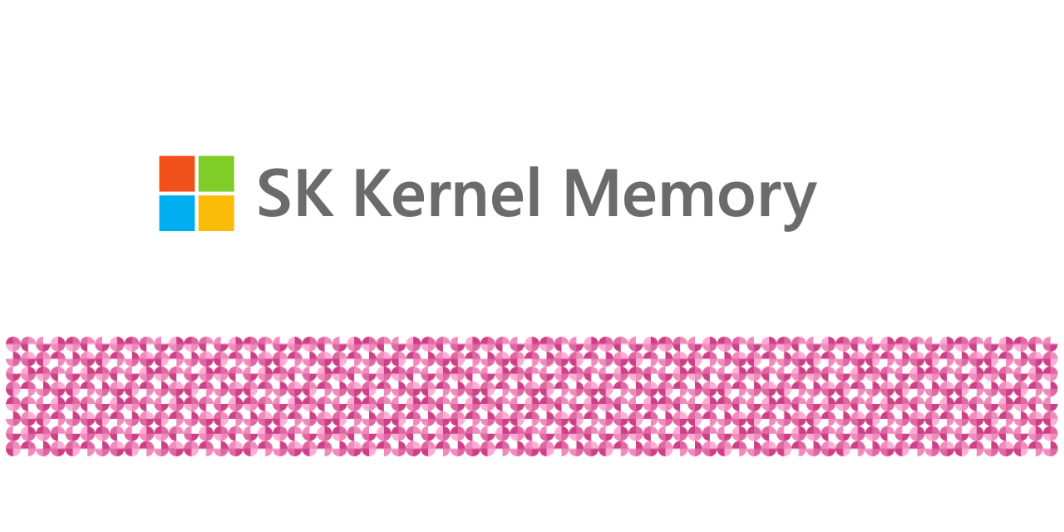
Introduction to Kernel Memory
Multi-model AI service for efficient indexing of datasets through hybrid pipelines.
Support for RAG, synthetic memory, prompt engineering, and custom semantic memory processing.
Available as a Web Service, Docker Container, plugin for ChatGPT/Copilot/Semantic Kernel, and .NET library.
Notes:
Hi everyone, my name is Will Velida – I’m a Software Engineer and Cloud architect and in this video, I’ll be introducing Kernel Memory.
Now, Kernel Memory is a multi-model AI service which specializes in the indexing of datasets through continuous data hybrid pipelines, with support for Retrievel Augmented Generation, synthetic memory, prompt engineering and custom semantic memory processing.
Kernel Memory supports lots of data types, such as PDF and word documents, PowerPoint presentations, images, spreadsheets and more. We can extract information and generate memories from documents using Large Language models, embeddings and vector storage. Using embeddings and Large Language models, Kernel Memory enables Natural Language queries for obtaining answers from data that’s indexed. We can also obtain information like citations, and links to original sources.
Kernel Memory is available as a Web Service, as a Docker Container, we can use it as a plugin for ChatGPT, CoPilots, and the Semantic Kernel. In a previous video, I showed how Kernel Memory can be used as a plugin for Semantic Kernel, and Kernel Memory can enhance our AI agents. We can also use it as a .NET library for embedded applications.

Slide 2
Difference between Kernel Memory and Semantic Memory
Kernel Memory
Semantic Memory
Provides features such as storing files, extracting text from files, secure data etc.
Codebase is entirely in .NET
Can be used from any tool, language, platform.
Library for C#, Python, and Java.
Wraps direct calls to DBs and supports vector search.
Part of Semantic Kernel project.
Notes:
So to start, let’s talk about the differences between Kernel Memory and Semantic Memory.
Kernel Memory (KM) is a service built on the feedback received and lessons learned from developing Semantic Kernel (SK) and Semantic Memory (SM). It provides several features that would otherwise have to be developed manually, such as storing files, extracting text from files, providing a framework to secure users' data, etc. The KM codebase is entirely in .NET, which eliminates the need to write and maintain features in multiple languages. As a service, KM can be used from any language, tool, or platform, e.g. browser extensions and ChatGPT assistants.
Semantic Memory (SM) is a library for C#, Python, and Java that wraps direct calls to databases and supports vector search. It was developed as part of the Semantic Kernel (SK) project and serves as the first public iteration of long-term memory. The core library is maintained in three languages, while the list of supported storage engines (known as "connectors") varies across languages.

Slide 3
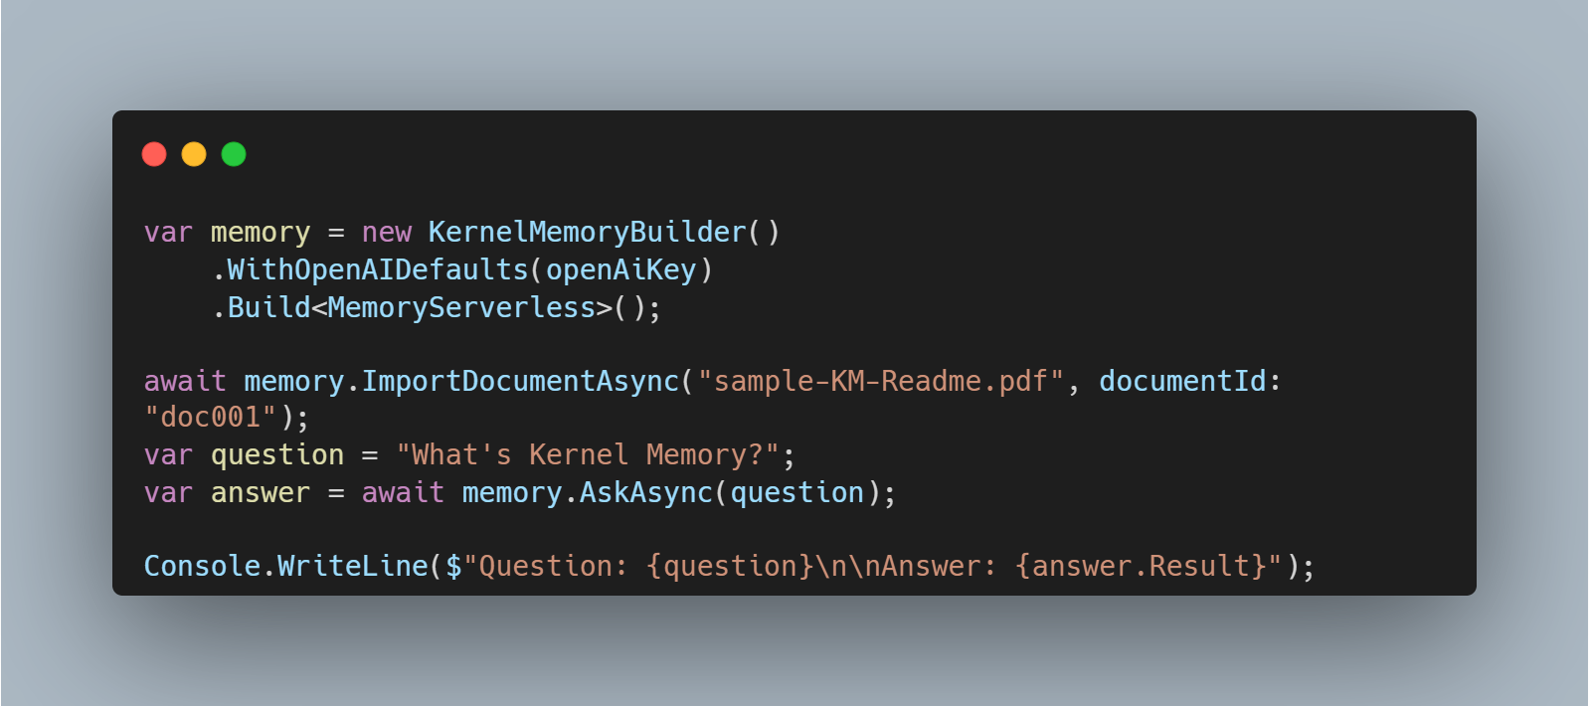
Kernel Memory in Serverless Mode
Kernel Memory works and scales best when running as a Web Service.
However, we can use it in serverless mode.
By default, this is volatile and keeps all data only in memory.
Notes:
So in this video I’ll show you how we can get started with Kernel Memory. In this video, we’ll talk about two methods that we can use : Serverless Mode and as a Web Service
Kernel Memory works and scales at best when running as a Web Service, allowing to ingest thousands of documents and information without blocking your app.
However, you can use Kernel Memory also in serverless mode, embedding the MemoryServerless class in your .NET app.
By default, this is volatile, and keeps all data only in memory, without persistence on disk.
MemoryServerless and MemoryWebClient implement the same interface and offer the same API, so you can easily switch from one to the other. However, since Serverless mode runs inside your application, it’s only available for .NET applications.

Slide 4
Using Kernel Memory Service
You can run your code locally inside your process, or remotely through an asynchronous service.
Deploy Kernel Memory as a service, plugging in default handlers, using non-blocking processes etc.
Deploy Kernel Memory as a Service if you’re:
Importing Data and sending queries to your web service
App is written in another language
Define custom pipelines mixing multiple languages
Importing big documents without blocking UI.
Running memory imports independently, supporting failures and retry logic.
Notes:
Depending on your scenarios, you might want to run all the code locally inside your process, or remotely through an asynchronous service.
If you're importing small files, and need only C# and can block the process during the import, local-in-process execution can be fine, using the MemoryServerless..
However, if you are in one of these scenarios:
I'd just like a web service to import data and send queries to answer
My app is written in TypeScript, Java, Rust, or some other language
I want to define custom pipelines mixing multiple languages like Python, TypeScript, etc
I'm importing big documents that can require minutes to process, and I don't want to block the user interface
I need memory import to run independently, supporting failures and retry logic
then you can deploy Kernel Memory as a service, plugging in the default handlers, or your custom Python/TypeScript/Java/etc. handlers, and leveraging the asynchronous non-blocking memory encoding process, sending documents and asking questions using the MemoryWebClient.

Slide 5
Demo
Running Kernel Memory in Serverless Mode and as a Web Service
Notes:
Let’s see this in action with a demo. We’ll run Kernel Memory in both Serverless Mode and as a Web Service, and then we’ll import some documents and ask it some questions

